Slide 1

RouterProxy
Introduction, Installation and Configuration

Slide 2
Introduction

Slide 3
What is RouterProxy
and why use it?
RouterProxy is a web-based tool used to run read-only CLI command against network devices
Exposes commands to the public for debugging connectivity issues
Allows for periodic polling of devices for accounting purposes

Slide 4
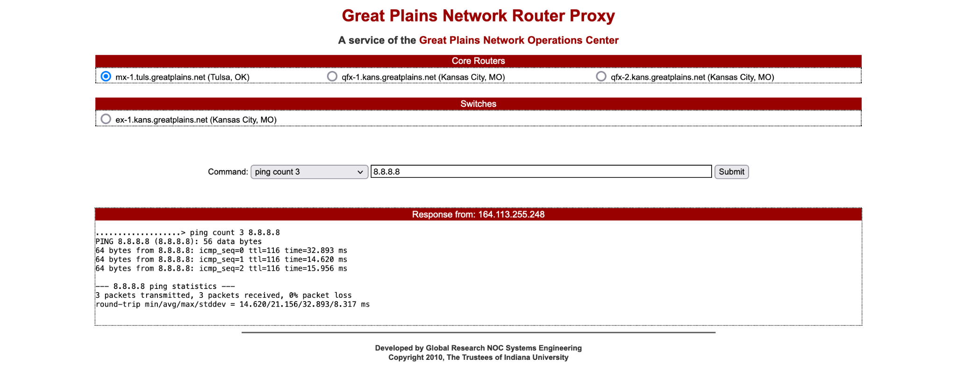
Production Example

Slide 5
RouterProxy
Primary Features
Multi-Vendor Support
Cisco, Juniper, HP and Many Others
Highly Customizable Interface
Organize devices into visually distinguishable groups
Color interface for branding purposes
Custom site name
Custom contact information
Multiple Connectivity Choices
Telnet
SSH
Decoupled Backend / Frontend
Allows for scriptable queries

Slide 6
RouterProxy
HTTP API
curl -X GET -G \ https://localhost:8080/?method=submit \ -d "device=192.168.65.2" \ -d "command=traceroute" \ -d "arguments=8.8.8.8" \ | sed 's/&nbsp;/ /g' .....................> ping count 3 8.8.8.8 PING 8.8.8.8 (8.8.8.8): 56 data bytes --- 8.8.8.8 ping statistics --- 3 packets transmitted, 0 packets received, 100% packet loss

Slide 7
GlobalNOC
Database
Integration
Add and remove devices from RouterProxy configuration
Assign command groups to devices
Keep device information like hostname and location up to date

Slide 8
Installation

Slide 9
Installation via RPM
[user@hostname]$ sudo tee /etc/yum.repos.d/globalnoc-public-el7.repo <<EOF > [globalnoc-public-el7] > name=GlobalNOC Public el7 - \$basearch > baseurl=https://repo-public.grnoc.iu.edu/repo/7/\$basearch > enabled=1 > gpgcheck=1 > gpgkey=https://repo-public.grnoc.iu.edu/repo/RPM-GPG-KEY-GRNOC7 > EOF [user@hostname]$ sudo yum makecache [user@hostname]$ sudo yum install -y grnoc-routerproxy

Slide 10
Installation via Docker
[user@hostname]$ git clone git@github.com:GlobalNOC/routerproxy.git [user@hostname]$ perl Makefile.PL [user@hostname]$ make container [user@hostname]$ docker run --detach --publish 8080:8080 --name routerproxy \ > --volume $PWD/conf/routerproxy.yaml:/etc/grnoc/routerproxy/routerproxy.yaml \ > routerproxy:2.2.0

Slide 11
Configuration

Slide 12
RouterProxy
Configuration
routerproxy.conf ( Apache )
Configure location of RouterProxy CGI, Static Files, and Templates
mapping.xml
Map HTTP Route to RouterProxy Config
Allows for multiple instances of RouterProxy per-WebServer
routerproxy.yaml
Setup per-Device Addresses, Credentials, and Metadata
Define Command Groups
Define Device Groups
Customize UI

Slide 13
RouterProxy Configuration
Apache
Alias /routerproxy /usr/share/grnoc/routerproxy/www
<Directory /usr/share/grnoc/routerproxy/www/>
Satisfy Any
Allow from all
AddHandler cgi-script .cgi
DirectoryIndex index.cgi
Options +ExecCGI
</Directory>
/etc/httpd/conf.d/routerproxy.conf

Slide 14
RouterProxy Configuration
HTTP Route
<mappings version="1">
<map
regexp="^\/.*routerproxy"
config_location="/etc/grnoc/routerproxy/routerproxy.yml" />
</mappings>
/etc/grnoc/routerproxy/mappings.xml

Slide 15
Some Quick Terminology
Devices
Network devices to run commands against
Device Groups
Organize devices into visually distinguishable groups
Command Groups
Associate set of commands with devices
Exclude Groups
Type of Command Group made of regular expressions used to block subsets of commands

Slide 16
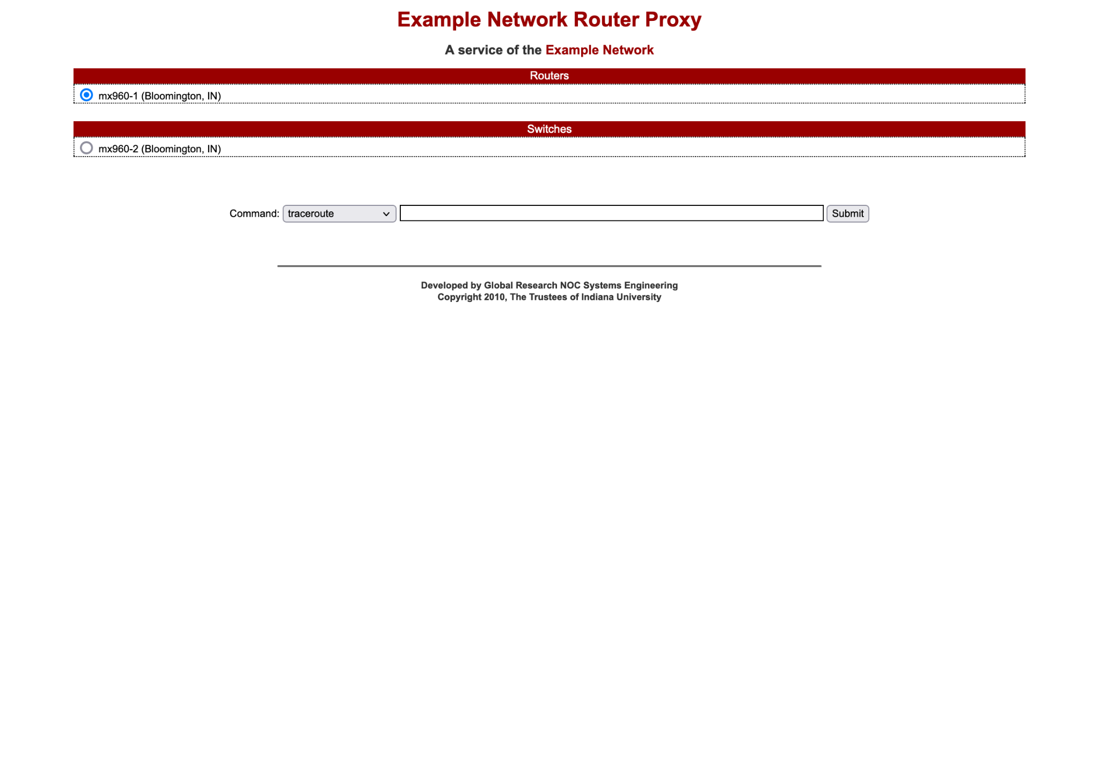
Example RouterProxy and Configuration

Slide 17
RouterProxy
Configuration
Application
---
device_group:
- name: Routers
description: My Example Routers
display: 1
- name: Switches
description: My Example Switches
display: 1
/etc/grnoc/routerproxy/routerproxy.yaml

Slide 18
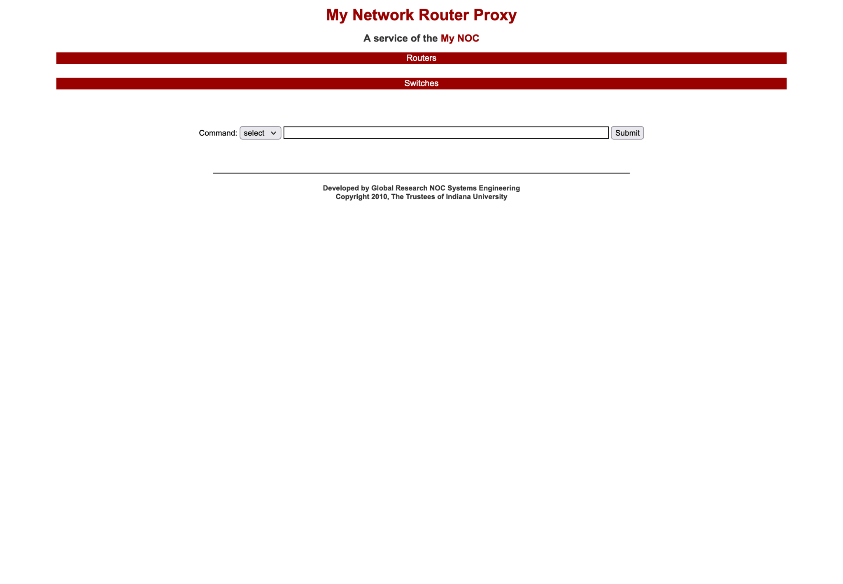
with Device Groups

Slide 19
RouterProxy
Configuration
Application cont.
---
device:
- name: mx960-1
address: 192.168.65.1
city: Bloomington
state: IN
device_group: Routers
type: junos
method: ssh
username: username
password: password
- name: mx960-2
address: 192.168.65.2
city: Bloomington
state: IN
device_group: Switches
type: junos
method: ssh
username: username
password: password
/etc/grnoc/routerproxy/routerproxy.yml

Slide 20
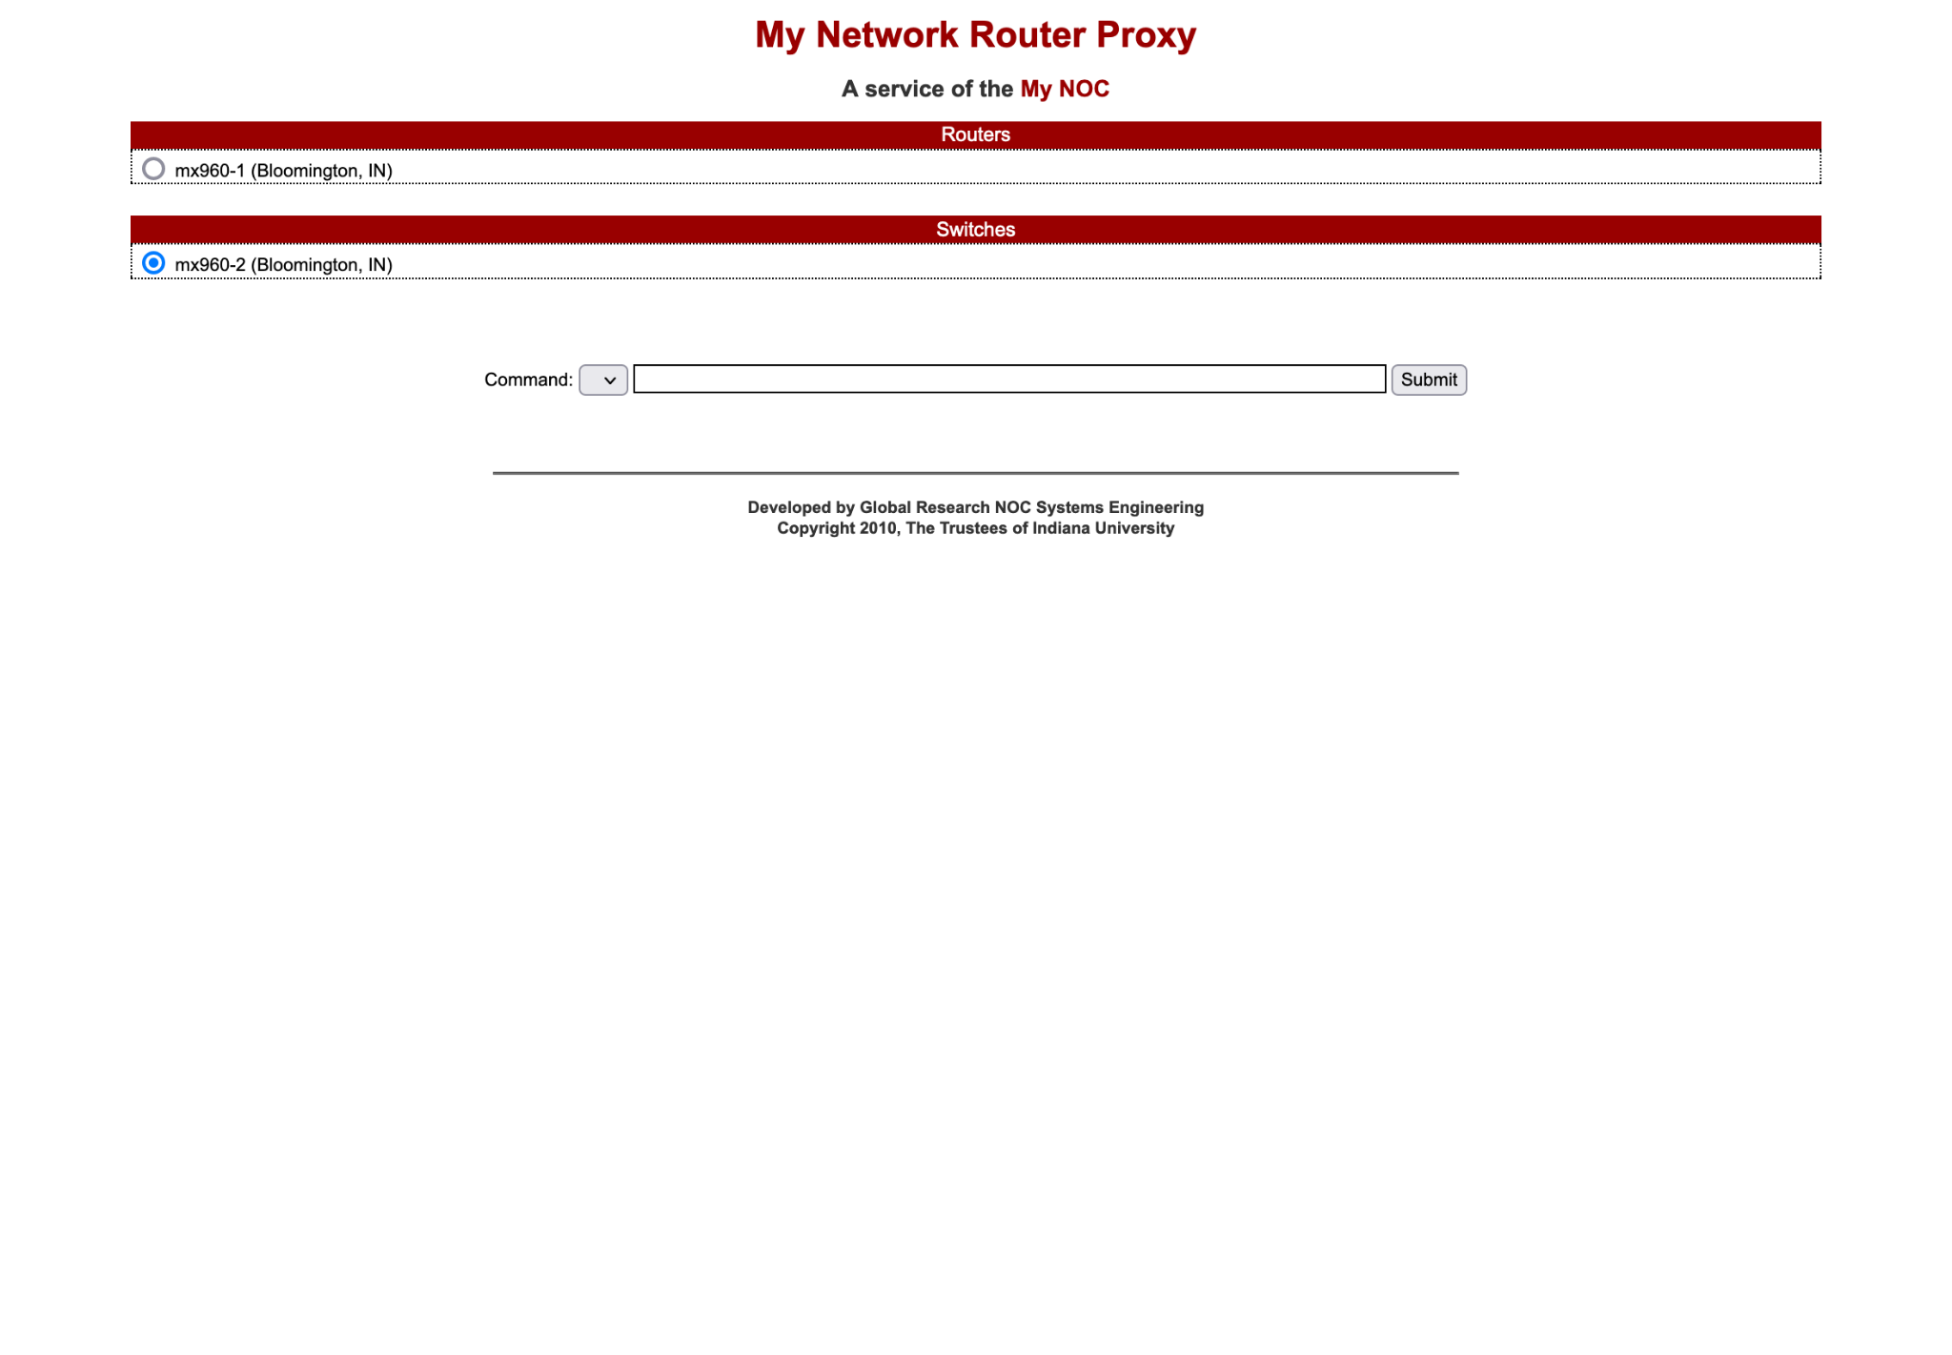
with Devices

Slide 21
RouterProxy
Configuration
Application cont.
---
command_group:
common:
- ping count 3
- show chassis
- show version
- traceroute
router:
- show bgp neighbor
- show rip
- show route
switch:
- show arp interface
- show interface
blocked:
- "\?$"
/etc/grnoc/routerproxy/routerproxy.yml

Slide 22
RouterProxy
Configuration
Application cont.
---
device:
- name: mx960-1
command_group:
- router
- common
exclude_group:
- blocked
- name: mx960-2
command_group:
- switch
- common
exclude_group:
- blocked
/etc/grnoc/routerproxy/routerproxy.yml

Slide 23
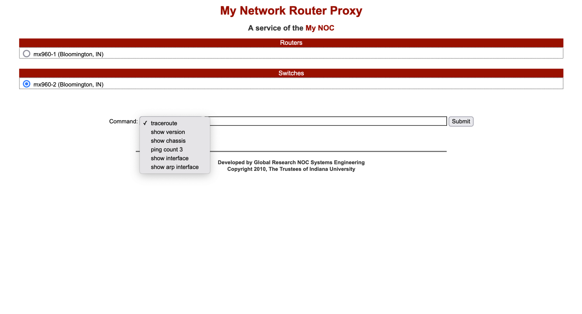
with Command Groups

Slide 24
RouterProxy
Configuration
Application cont.
---
frontend:
dropdown: 0
help: Additional help text
network_name: Example Network
noc_mail: noc@example.net
noc_name: Example Network
noc_site: https://example.net
/etc/grnoc/routerproxy/routerproxy.yml

Slide 25
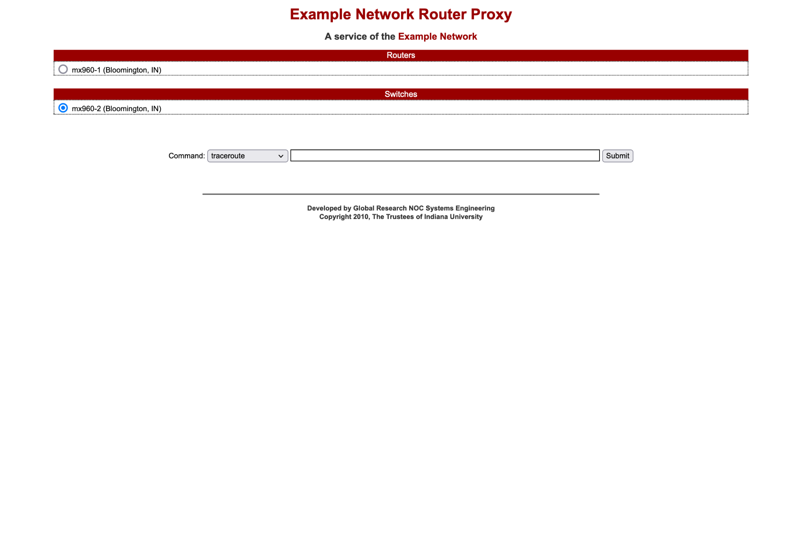
with Frontend Customization

Slide 26
RouterProxy
Configuration
Application cont.
---
general:
logging: /var/log/routerproxy.log
max_lines: 2500
max_rate: 25
max_timeout: 60
redact:
- (?<=\+)\d+
/etc/grnoc/routerproxy/routerproxy.yml

Slide 27
Questions?
RouterProxy on Github: https://github.com/GlobalNOC/routerproxy/
Name: Jonathan Stout Email: jonstout@globalnoc.iu.edu Slack: jonstout

